Slide 1
Mini Presentation 6
2 September 2020

Slide 2
NLP - Sentiment Analysis
IMDB movie review dataset in kaggle (IMDB dataset (Sentiment analysis) in CSV format)
Approach taken as per Lab 9.6
Import libraries
Load data
Inspect data (EDA)
Prepare the stage
ie load spaCy
Prepare the text
All the text handling and preparation concerned with the changes and modifications from the raw source text to a format that will be used for the actual processing
Work the text
Concern with the meaning and the substance of the content to extract actual information.
Modelling
Validation

Slide 3
Approach - Details
Load data – use train.csv for training the model
Prepare the text
reduce multiple spaces and newlines to only one
remove double quotes
remove < br />
Work the text
Remove StopWords, Punctuation, Lemmatize
Classifier algorithm used – SVM
Feature Extraction used – Bag of Words and TF-IDF

Slide 4
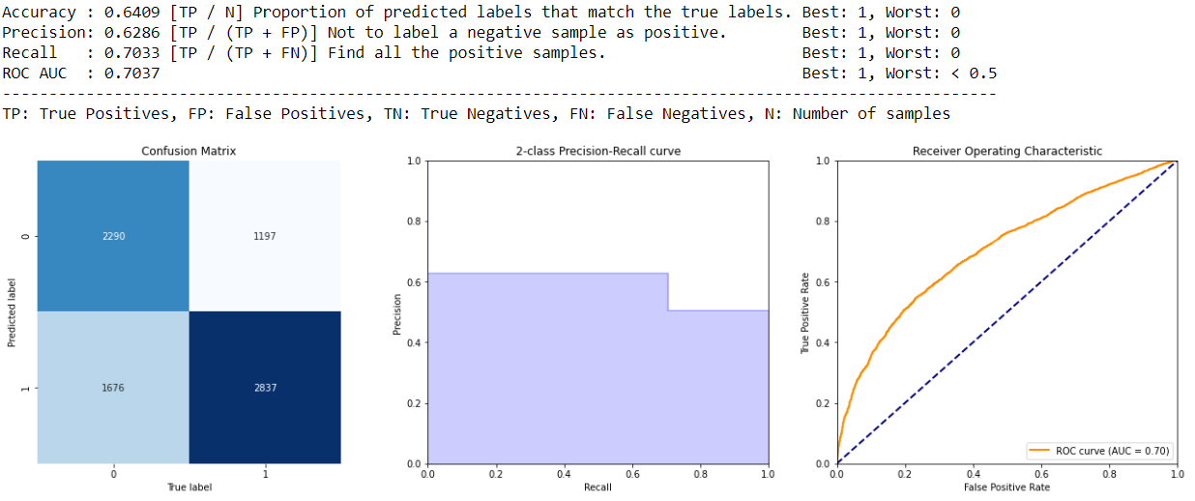
Model Summary Report – Bag of Words

Slide 5
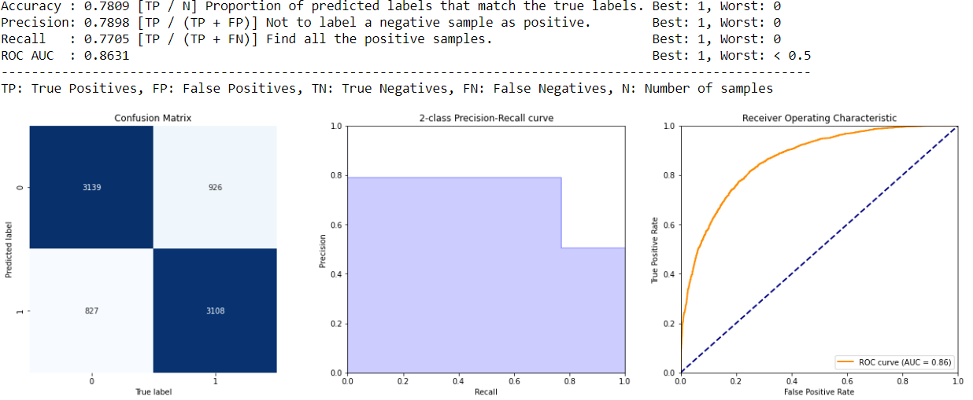
Model Summary Report – TF-IDF
TF-IDF has better scores than Bag of Words

Slide 6
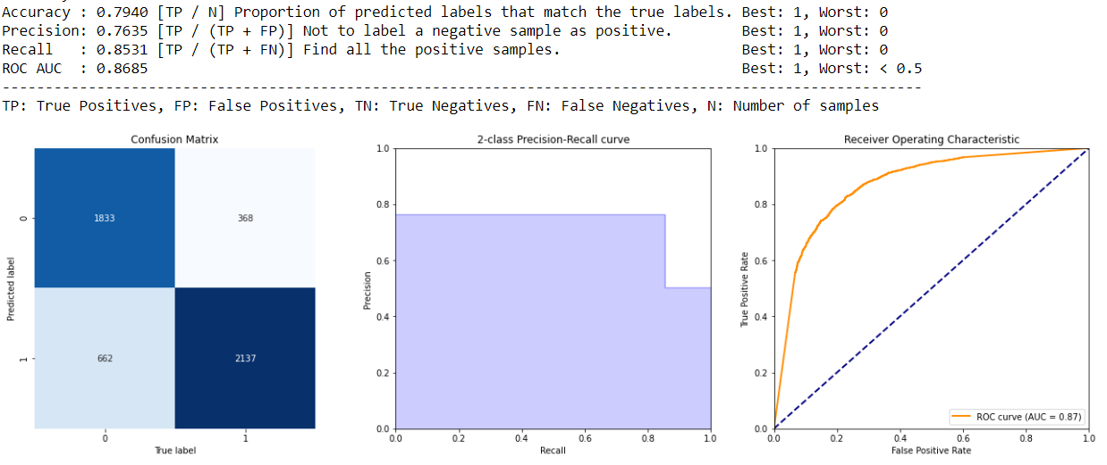
Validation Summary Report – Bag of Words
Used dataset ‘test.csv’

Slide 7
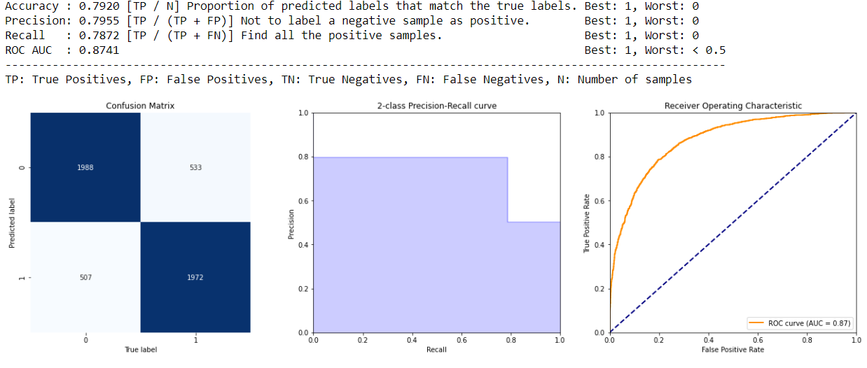
Validation Summary Report – TF-IDF
Used dataset ‘test.csv’
Bag of Words has higher Recall score than TF-IDF and comparable scores for the rest !

Slide 8
Appendix

Slide 9
NLP - Sentiment Analysis
IMDB movie review dataset in kaggle (IMDB dataset (Sentiment analysis) in CSV format)
in your report, highlight the accuracy, f1 scores etc. comment on the type of word features you use.. tf-idf etc.. are they effective etc.?

